Slide 1
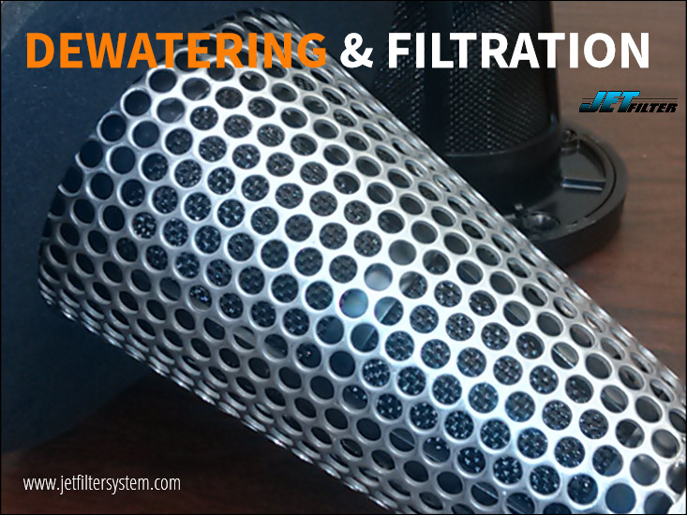
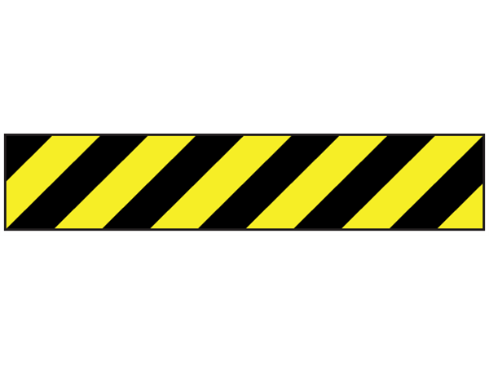

JETFILTER SYSTEM LLC
Business Presentation
A Dewatering Filtration System
US PAT # 7,615,148

Slide 2
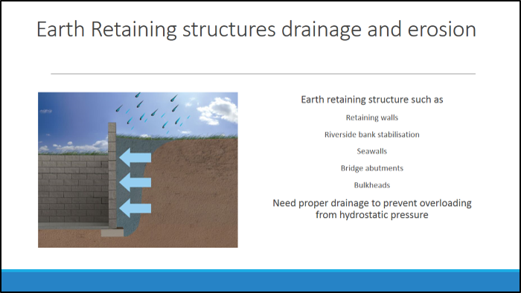

Slide 3
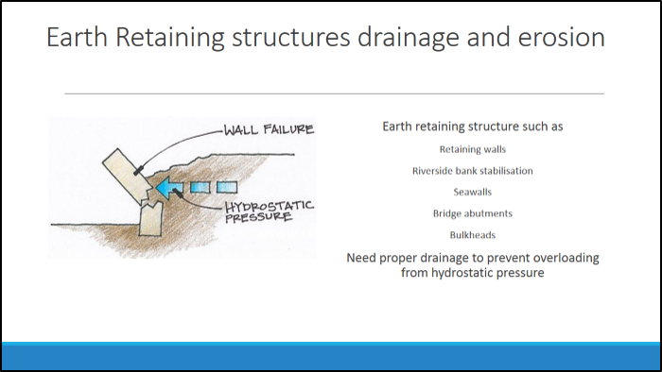

Slide 5
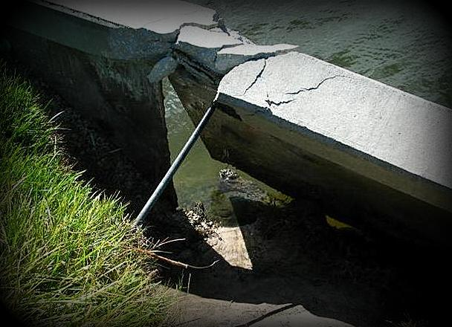
COMMON ISSUES
The vast majority of retaining structure failures occur due to the build-up of excessive hydrostatic (water) pressures due to either a lack of adequate drainage or impermeability of the backfill materials.
Ports, Harbors and Marinas experience extreme rising and falling water levels and intense storms that cause groundwater to build up behind the wall. Structures that don’t have an adequate drainage system have increased hydrostatic pressure causing additional stress on the structure.

Slide 6
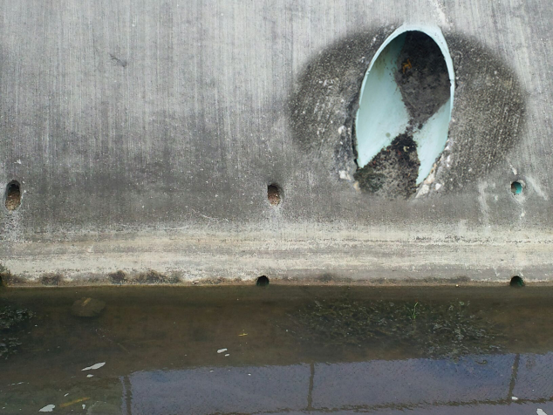
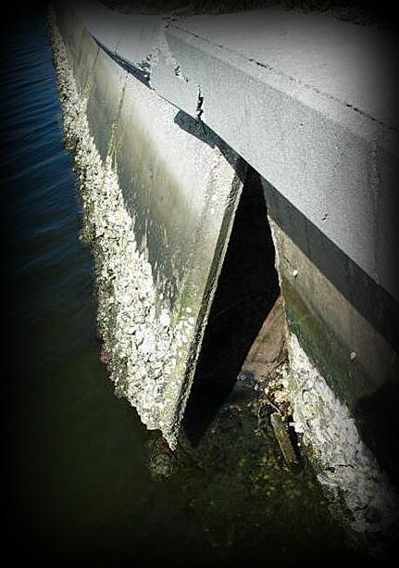
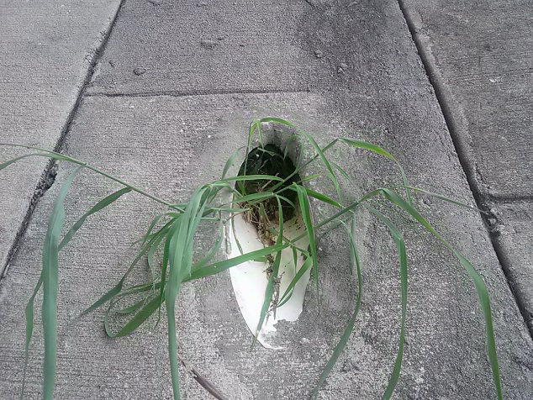
COMMON ISSUES
Filtration and drainage are a vital part of designing Earth Retaining Structures including coastal retaining walls, bridge abutments, storm water channels, and all types of sheet piles etc.

Slide 7
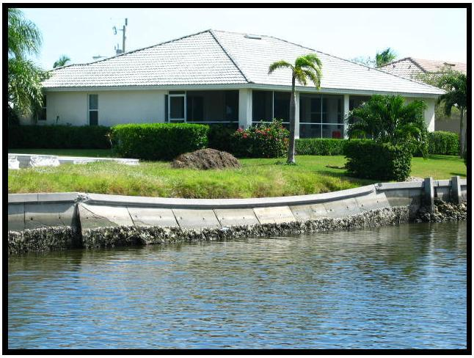
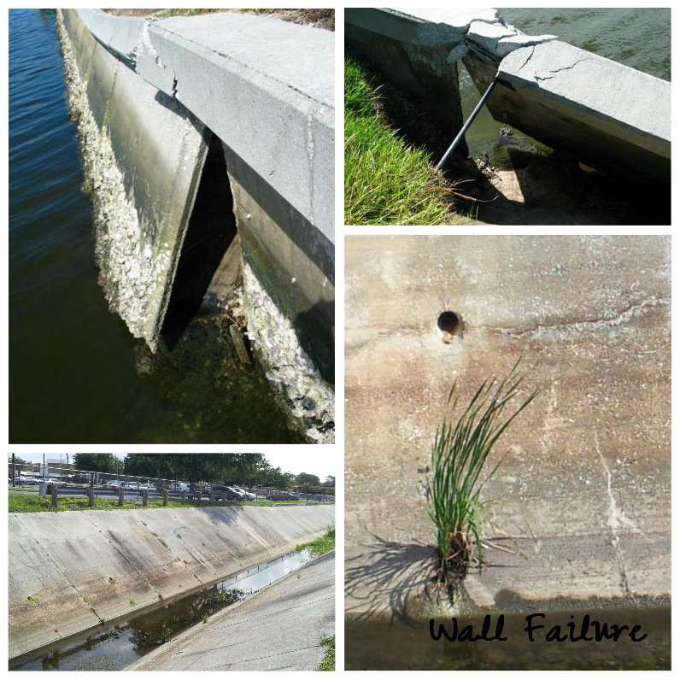
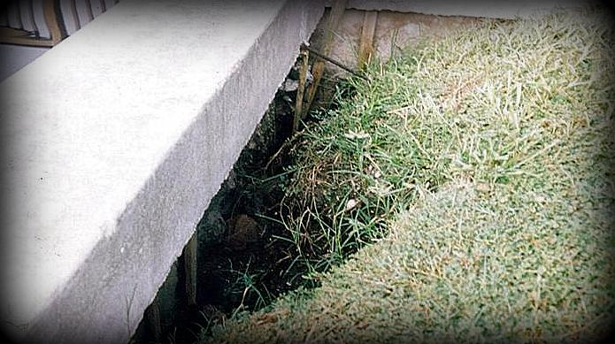
COMMON PROBLEMS

Slide 8
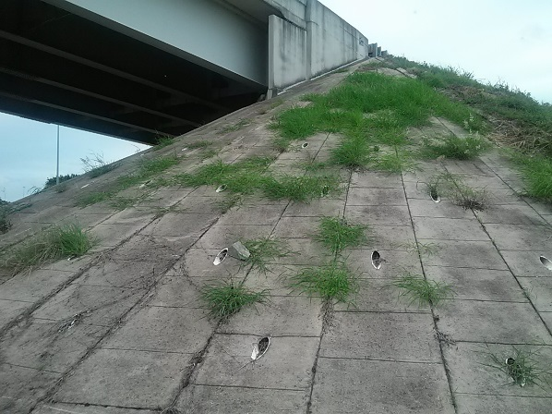

ENGINEERING SOLUTIONS
The standard retaining/seawall consists of a steel reinforced concrete slab or sheet piling driven into the soil or foundation. If the waterside/foundation soil is washed or dredged away, the bottom of the wall may slide outward resulting in collapse of the entire wall. The top of the wall is held in a vertical position by steel tie rods led back to heavy concrete blocks called dead men. Over time, these steel rods corrode this, combined with the hydrostatic pressure of perched water, may result in wall movement and ultimately failure.

Slide 9
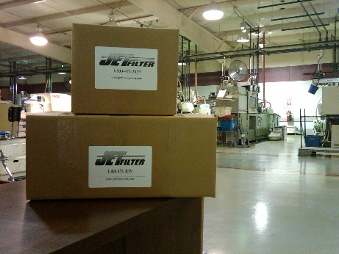
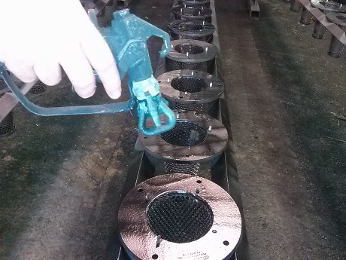
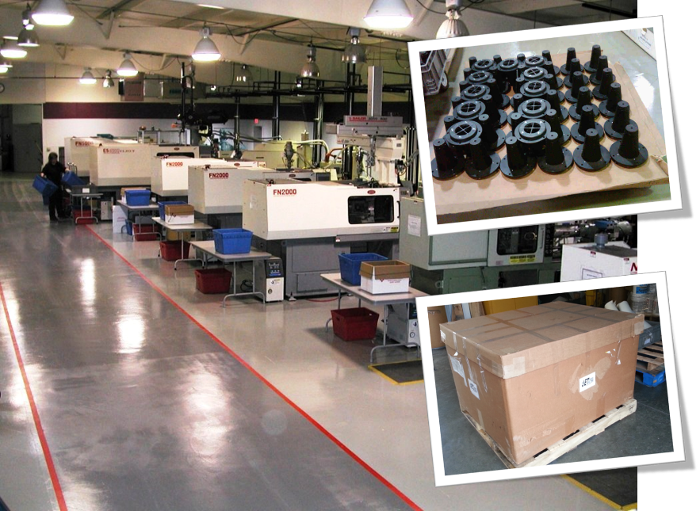
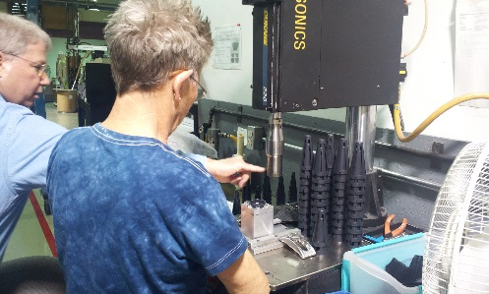
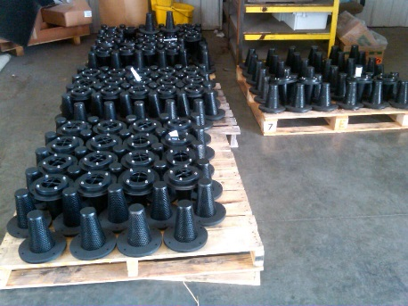
MANUFACTURING
Our state-of-the-art facility teamed with MSI and D-M Manufacturing, JET Filter System, LLC can improve the products manufacture ability through the application of advanced technology and automation, by reducing cost.
www.jetfiltersystem.com
Based: Illinois USA
An Illinois Corporation Est: 2005

Slide 10
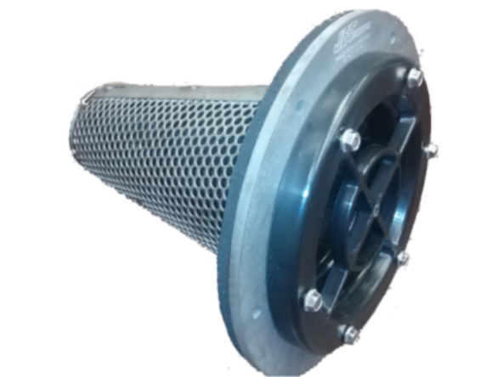
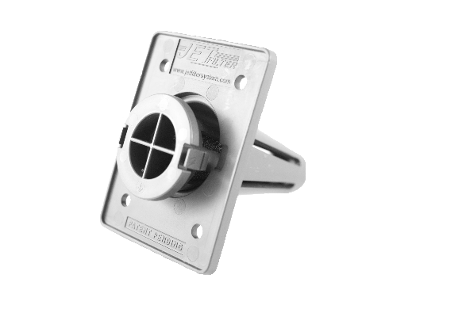
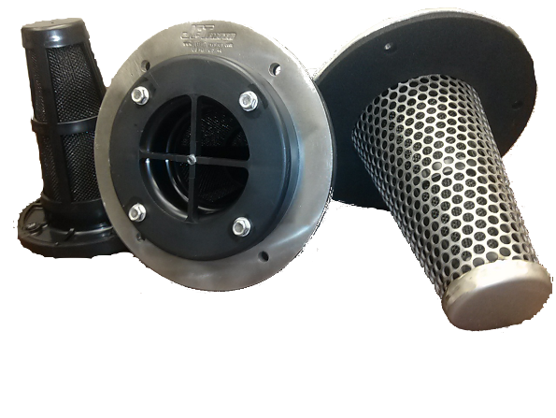
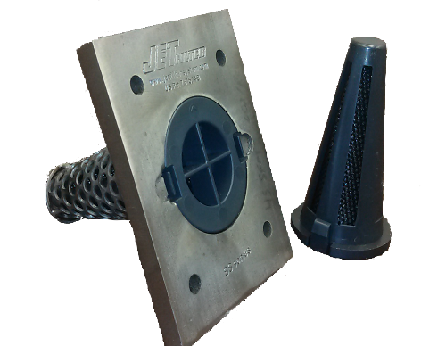
Business Concept
AVAILABLE IN 3 DIAMETERS
ABS & 316 Stainless Steel
SS 6” Dia.
ABS 2 ½” Dia.
SS 4” Dia.
SS Steel 2 ½” Dia.
United States Patent #7,615,148

Slide 11
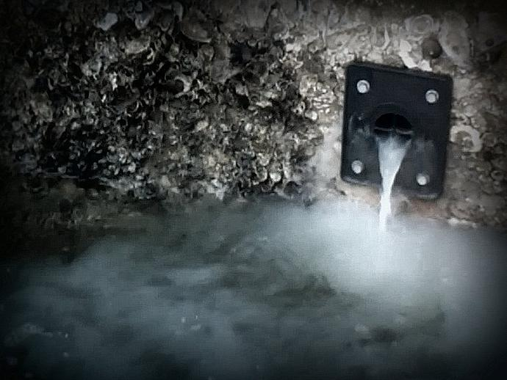
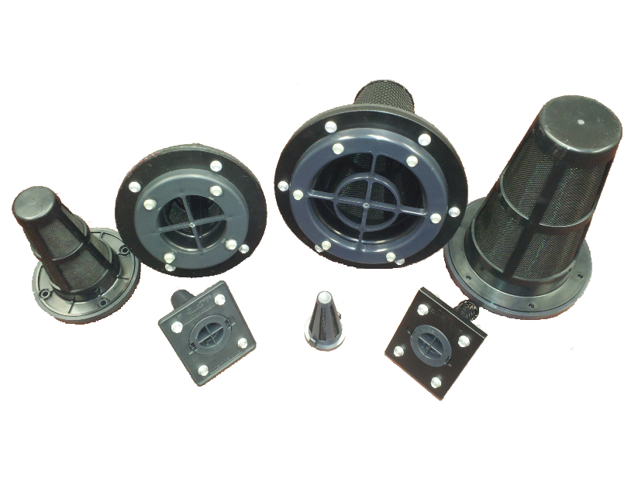
Business Concept
Backed by civil engineers, marine contractors, project managers, government and state officials. A lack of erosion control is a vital issue among a retaining wall design. One common problem is wall movement in addition to tieback/whaler tension, toe failure, horizontal cracking and panel separation.
Weep holes are created to relieve the hydrostatic and hydrodynamic water pressure from behind the wall without causing soil loss and/or sinkholes. It's very important to have access to the erosion control fabric from behind the wall that inevitably will clog and/or deteriorate over time if not properly maintained.

Slide 12
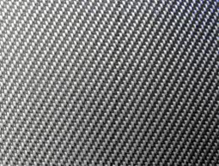
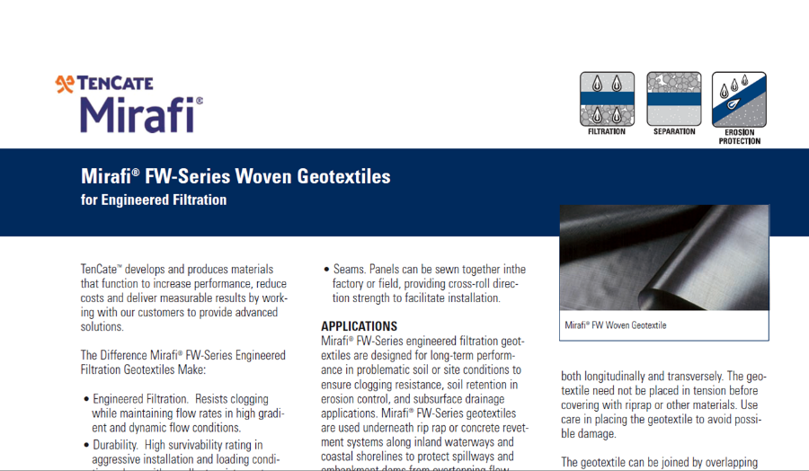
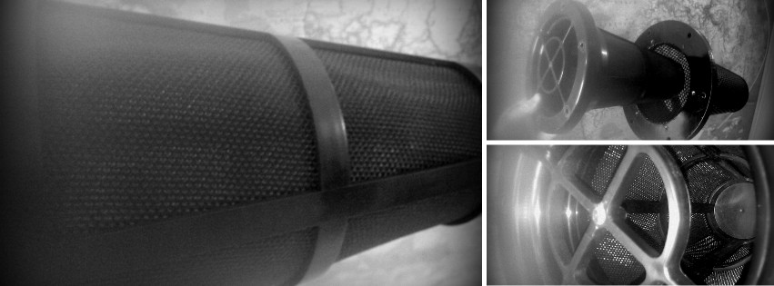
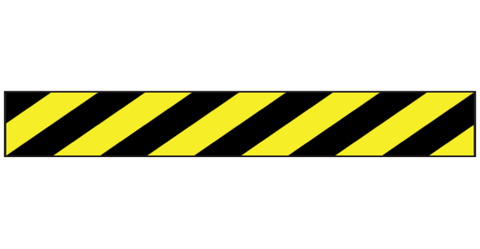
Business Concept
GEOTEXTILE FILTRATION AND EROSION CONTROL​​​​​​​​​​​
The media equipped in the JET Filter System is the highly rated Mirafi® Filter-weave FW 300 series.
This media maintains long-term flow rates in high gradient and dynamic conditions.

Slide 13
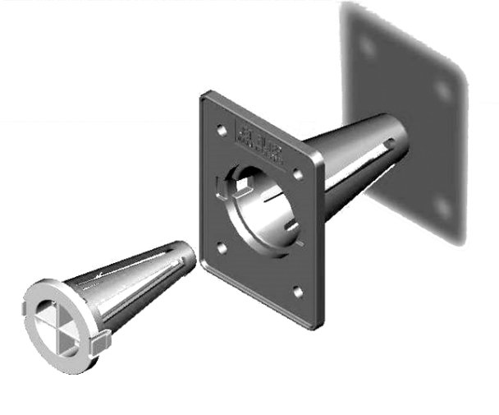
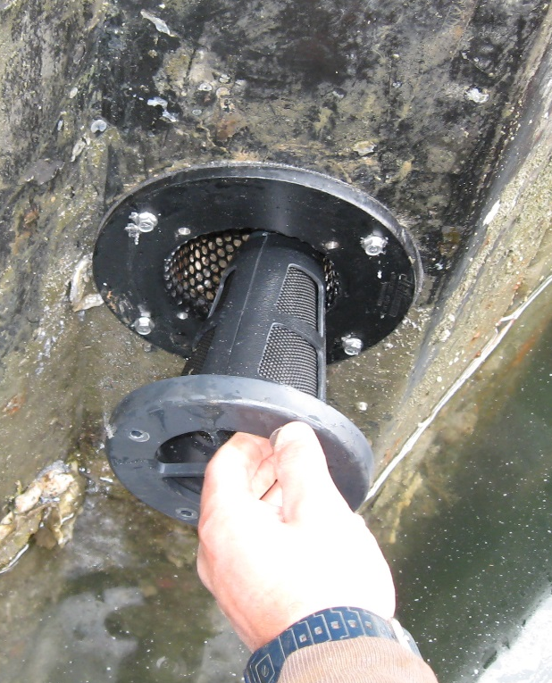
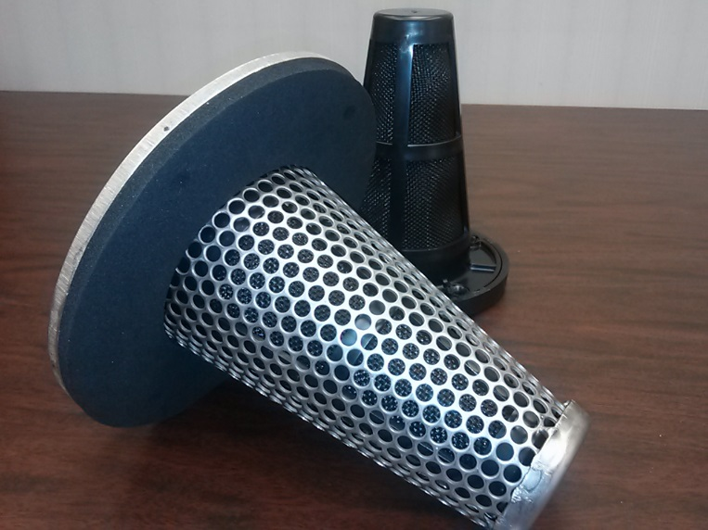
Business Concept
The key component of the flush-mount dewatering JET Filter System is the ability to remove the inner filter cartridge from the front face of any retaining wall design which can be maintained to get the most life expectancy of any wall installed.
The weep hole systems can be easily installed on any new or existing earth retaining structures.

Slide 14
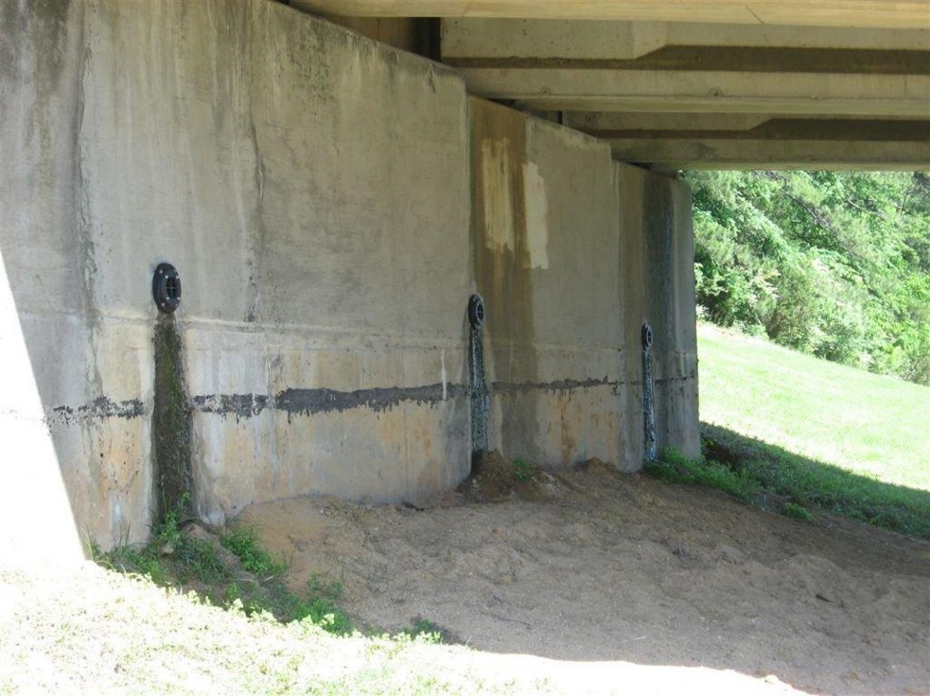
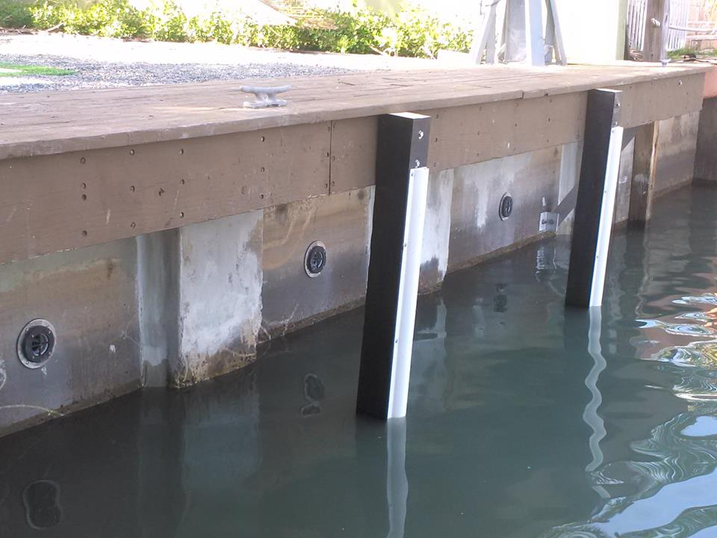
INSTALLATION
Money can be saved with preventative maintenance. With the JET Filter installed every 4-6 feet on center, Water pressure can be released without taking its valuable soil causing erosion or sink holes.
This flush mount system is easily installed and maintained from the face side of the wall for a comparatively low cost.

Slide 15

INSTALLATION
  The JET Filter System is unique in its design to prevent erosion of backfill materials caused by transport of the fill material fines through the Earth Retaining Structure weep holes and/or panel seams. The hydrodynamic pressure of perched water and seepage water causes loss of landfill without the proper erosion control system.
The JET Filter System relieves this pressure and has an unlimited design life.

Slide 16
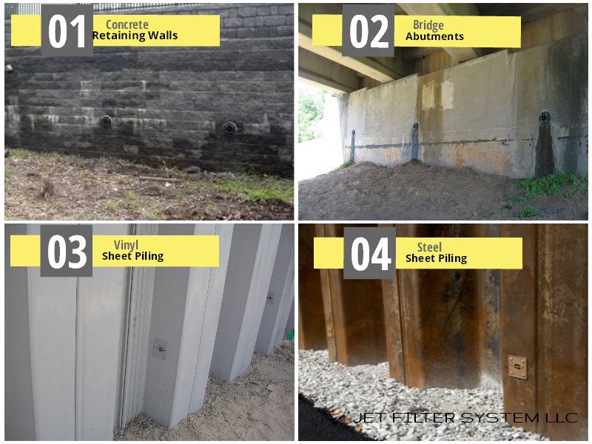
Market Summary
TRANSPORTATION • MARINE • RAIL • RESERVOIR
Bridge, Marine, Rail, Landscaping Infrastructure such as
Bridge Abutments & Wing Walls
MSE Retaining Walls
Steel Sheet Piling
Vinyl Sheet Piling
Concrete Seawalls
Wooden Bulkheads
Aluminum/Composite Sheet Piling
Highway/Pavement Drainage
Concrete Detention Basin

Slide 17
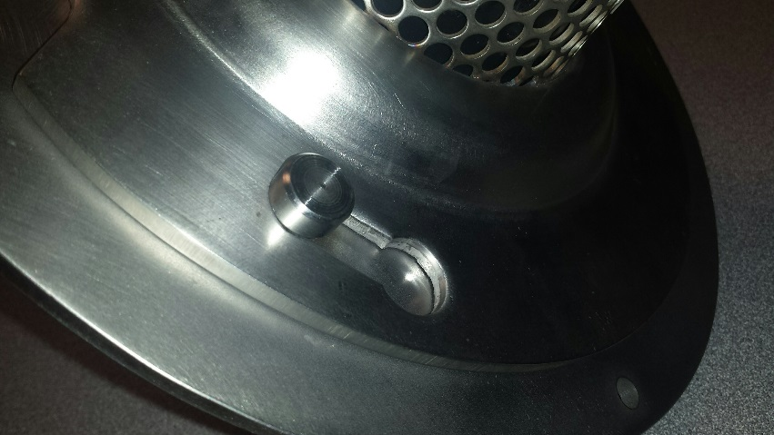
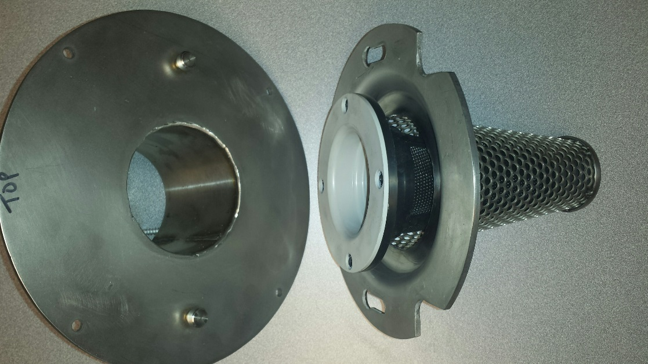
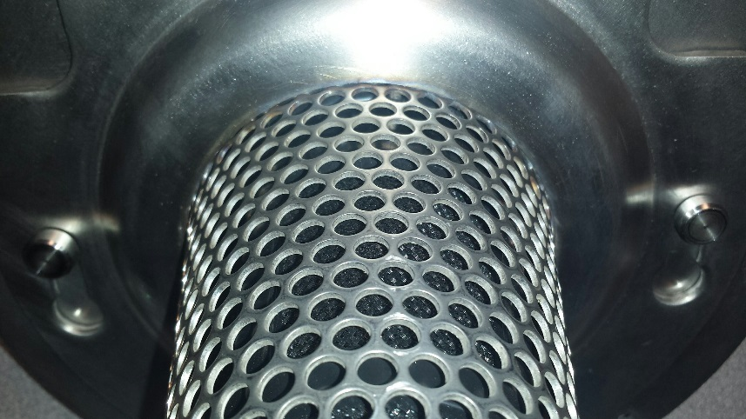
COMING SOON
Bio-Treatment Catch Basin Storm Water Filter (4”dia. Outlet)​​​​​​​​​​​

Slide 18

ReFERENCES
List of approval applications/projects
  Missouri Dept. of Transportation
  Alaska Dept. of Transportation
  Indiana Dept. of Transportation
  Nebraska Dept. of Transportation
  Michigan Dept. of Transportation
  Colorado Dept. of Transportation
  Texas Dept. of Transportation
  Illinois Dept. of Transportation
  Maine Dept. of Transportation
  Virginia Dept. of Transportation
  Pennsylvania Dept. of Transportation
  New Hampshire Dept. of Transportation
  Federal Highway Administration
  National Park Service
  Army Corps of Engineers
  USDA/NRCS
  Florida Power & Light
  North Carolina Wildlife Resources Commission
  CSX Rail
  Southwest Florida Water Management District
  St. Johns River Water Management District
  Pinellas County FL Utilities Dept. of Solid Waste
  Tennessee Valley Authority
  Walt Disney Golf Courses
  Port of Houston Texas
  North Carolina Wildlife Resources Commission
  Waterview Connection New Zealand
  Imperial Oil
  Exxon Oil
  Mosman Council Sydney Australia
  Canada Bridge King’s Highway 7/401
  Michigan City Port Authority
  City of Lake Park Florida
  City of Salisbury Maryland
  City of Orlando Florida
  City of Dallas Texas

Slide 19
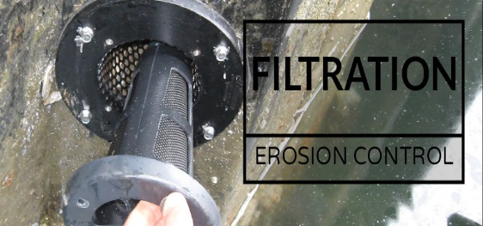
CONTACT
“Contact us today for your Dewatering Solutions”
Failure to provide weep hole relief could result in devastation ~ wall failure
Web: www.jetfiltersystem.com
800-475-2029

